Slide 1
AI Gym Trainer
Harshit
Deepti
Sejal
Aditya

Slide 2
INTRODUCTION
We will be using computer vision techniques and the MediaPipe and OpenCV libraries to detect and track the movement of the arm during bicep curls and the body during plank position, use machine learning to classify the movement as a left or right curl and check the correctness of the plank position.
The system will be able to detect and count bicep curls and check the plank position from a single person in real-time with a webcam.
The presentation will cover the problem statement, methodology, results, and conclusion of the project, as well as future work that can be done to improve the system.
This system has the potential to revolutionize the way that people track and monitor their muscle growth, proper form and fitness progress.

Slide 3
PURPOSE
The purpose of this project is to develop a real-time system that can accurately detect and count left and right bicep curls, as well as check the correctness of the plank position using the MediaPipe and OpenCV libraries.
This system has the potential to revolutionize the way that people track and monitor their muscle growth, proper form and fitness progress.

Slide 4
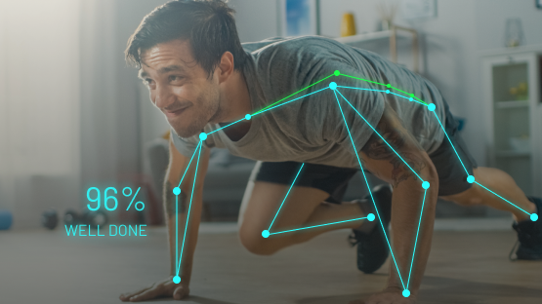
PROBLEM STATEMENT
The ability to accurately measure and track bicep curl exercise and plank position is important for monitoring muscle growth, proper form and progress, but current methods are often time-consuming and unreliable.

Slide 5
METHODOLOGY
We used MediaPipe's pre-trained TensorFlow models to detect the key points of the body, including the shoulders, elbows, and wrists.
Using the key points detected by MediaPipe, we calculated the angles between different body parts using OpenCV's geometric transforms.
We used the angles calculated in the previous step to determine the movement of the arm during a bicep curl and classify it as a left or right curl.
By measuring the angles of the key points of the body, we were able to determine if the plank position is correct or not.
The system was designed to process video streams in real-time using a webcam, allowing the user to see the results of the detection and counting in real-time.

Slide 6
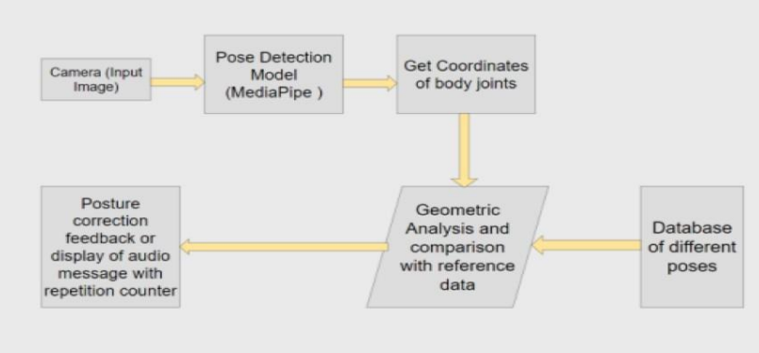
IMPLEMENTATION

Slide 7
RESULTS
The system is designed to provide real-time feedback to the user, allowing them to see the results of the detection and counting in real-time.
The system is able to accurately measure and track bicep curls and plank position, helping users monitor their muscle growth, proper form and progress.
The system is efficient and accurate, providing an alternative to manual counting methods that are time-consuming and unreliable.

Slide 8
CONCLUSIONS
Our project aims to develop a real-time system that can accurately detect and count left and right bicep curls, as well as check the correctness of the plank position using the MediaPipe and OpenCV libraries.
This system has the potential to revolutionize the way that people track and monitor their muscle growth, proper form and fitness progress, providing an accurate and efficient way of measuring and tracking progress.

Slide 9
REFERENCES
We have used OpenCv library of python to develop this project. https://docs.opencv.org/4.x/
We have also used Mediapipe in this project. https://google.github.io/mediapipe/
Python Documentation https://docs.python.org/3/

Slide 10
THANK YOU

